Slide 1
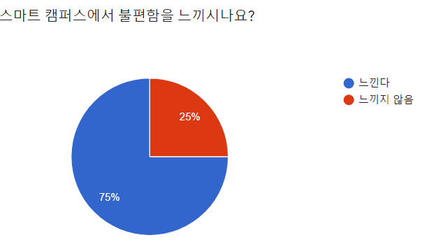
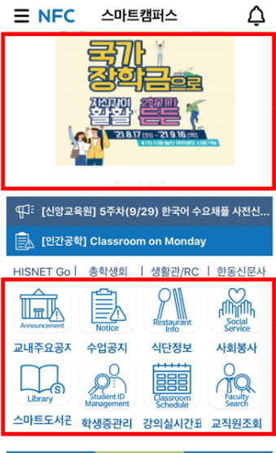
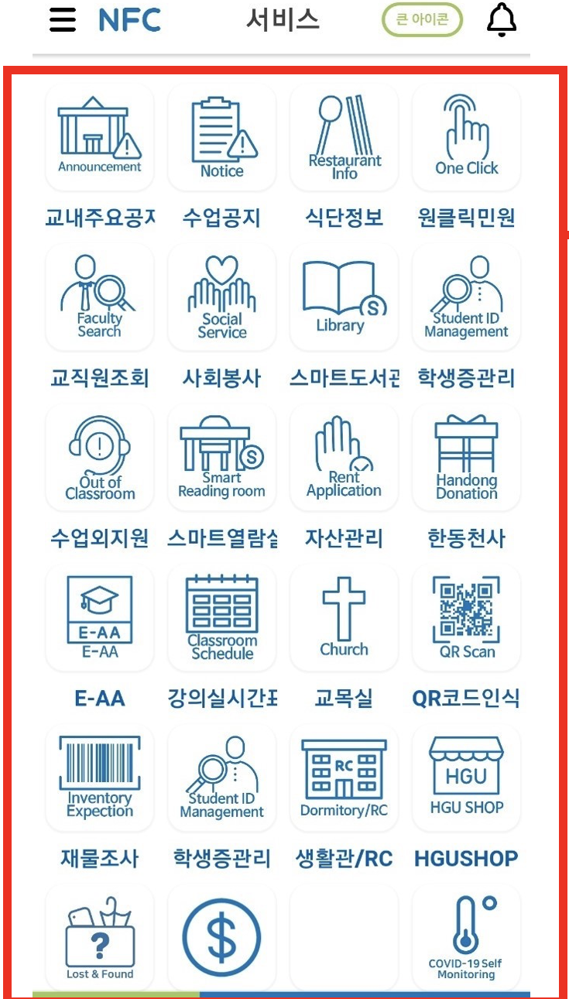
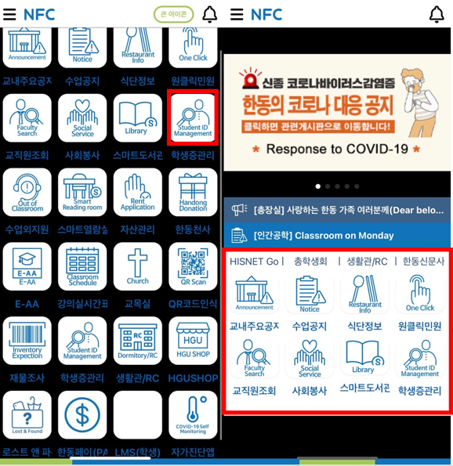
Background
Problem Cognition
Slow loading speed of the screen
login errors and server collisions
QR tagging not being on the main screen
complicated menu
configuration access multiple functions
Problem Definition
Main screen
Menu screen
Dark Mode
Large Banner
Unused function
Too many function
Unnecessary functions
Not User-friendly designed
Eye Fatigue
Solution

Slide 2
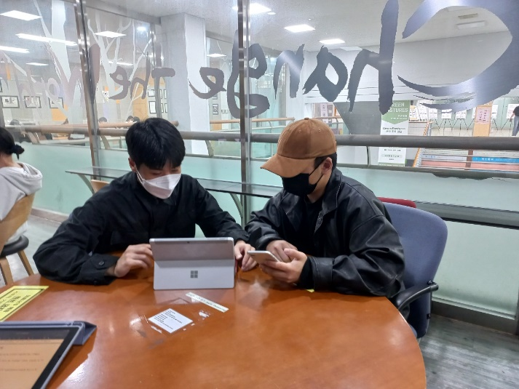
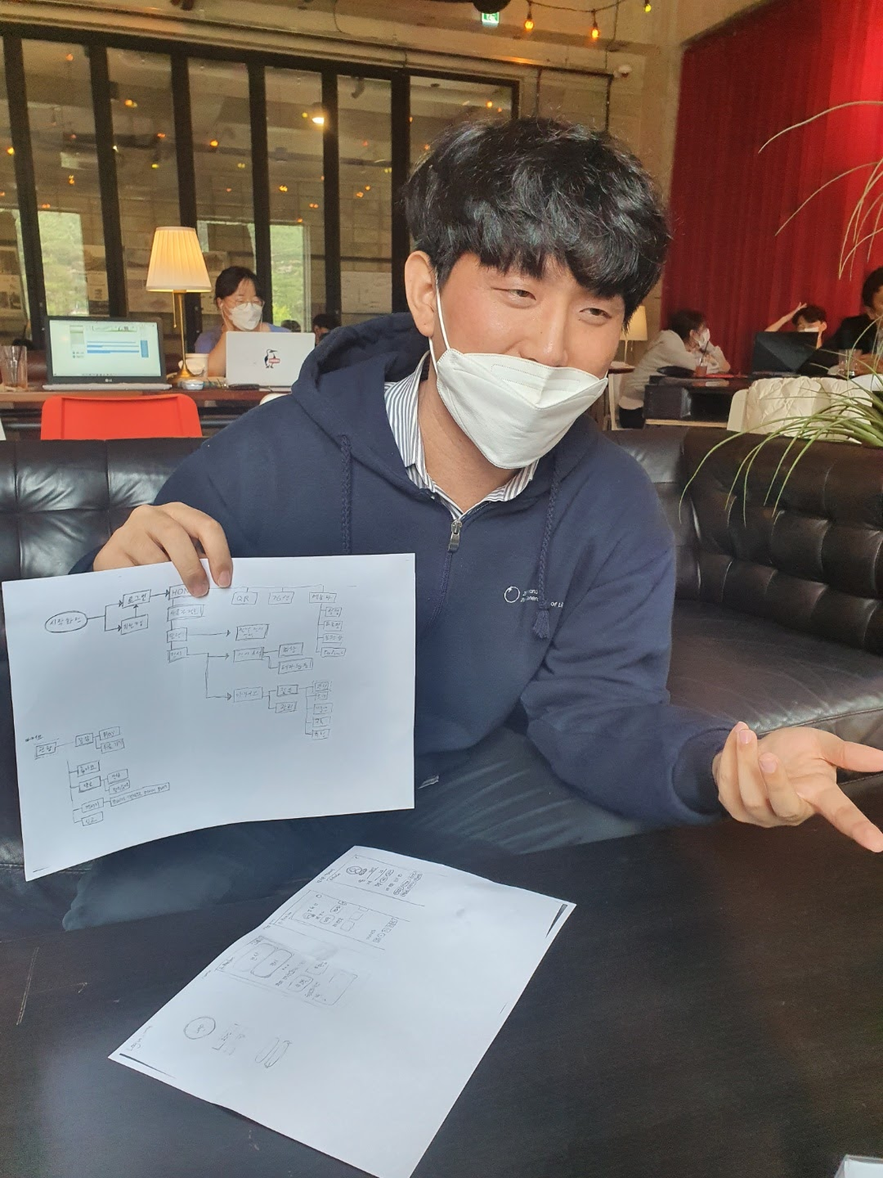
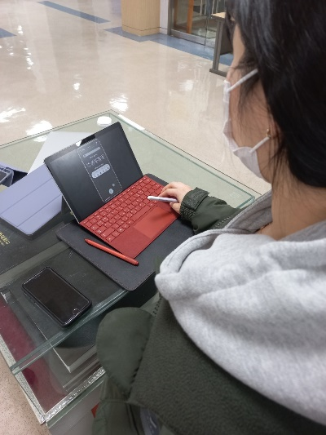
In order to prove the justification of this background, interviews were conducted with 18 people.

Slide 3
Q. What's the most inconvenient thing about smart campus applications?
Uncomfortable due to lack of function
: Bus time 302, information on convenience facilities in school, HISNET mobile version, dark mode.
B. Inconvenient in functioning
: One-click civil complaints, application for a stay out of the dormitory, biometric authentication time of Handong Pay, inconvenience of moving the screen slide, error when accessing the notice, confirmation and time of dormitory ID, and some menus are not even executed properly.
C. Uncomfortable due to functional congestion
: The interface is messy, too many menus, icons and menu names are not intuitive.

Slide 4
Purpose of prototype
Our group planned to solve the areas that could cause cognitive errors(human error) first, since it was difficult to solve the problem caused by abnormalities in functions at the prototype stage.
In addition, the purpose was to add a new function that considers the user's physical characteristics.

Slide 5
Plan for Prototype
Setting personal quick menu “My Favorite Menu”
Organizing the placement of the Start Screen
Classification of functions
Improvement of Dark mode
Notification for New announcement

Slide 6
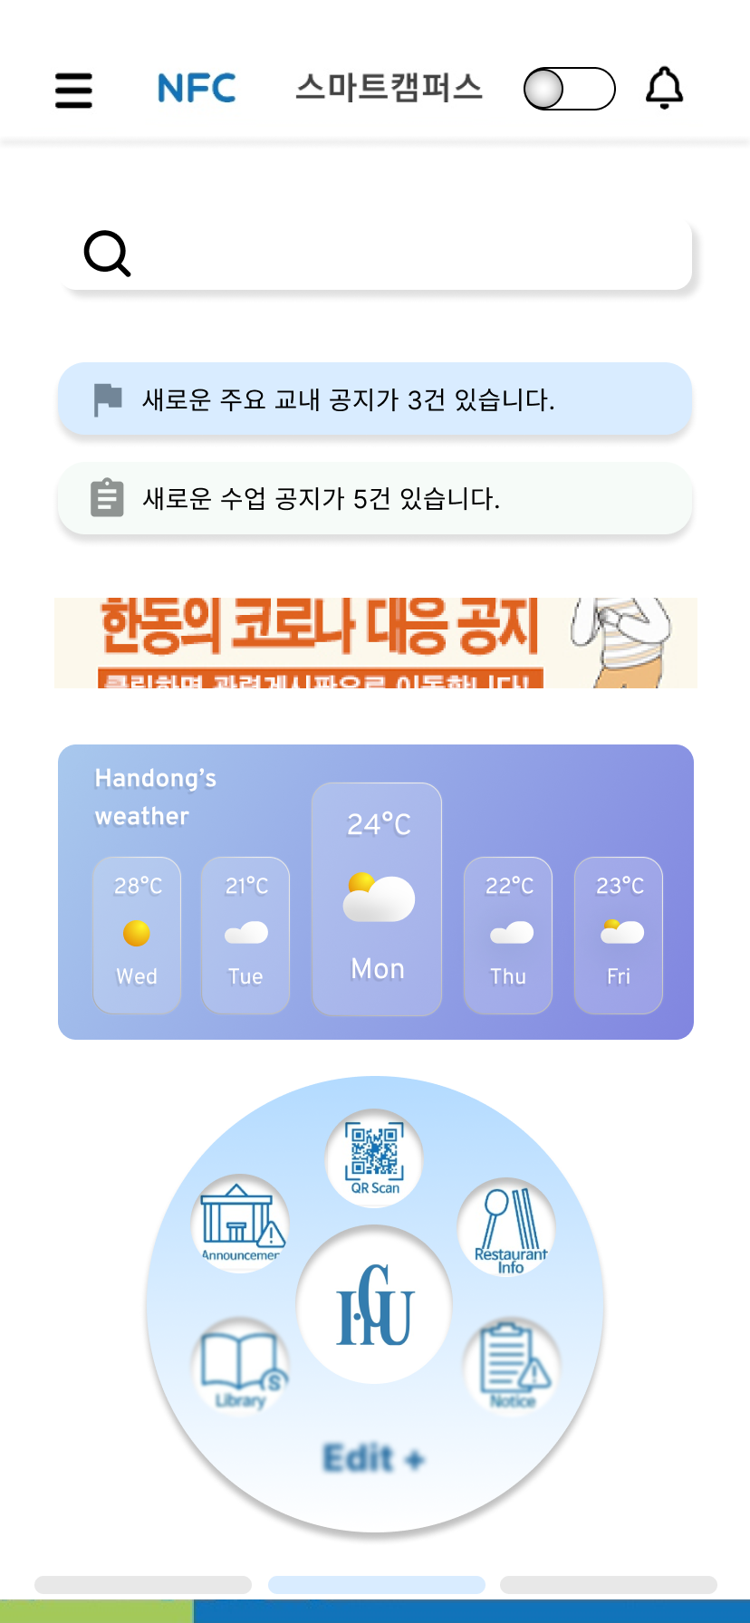
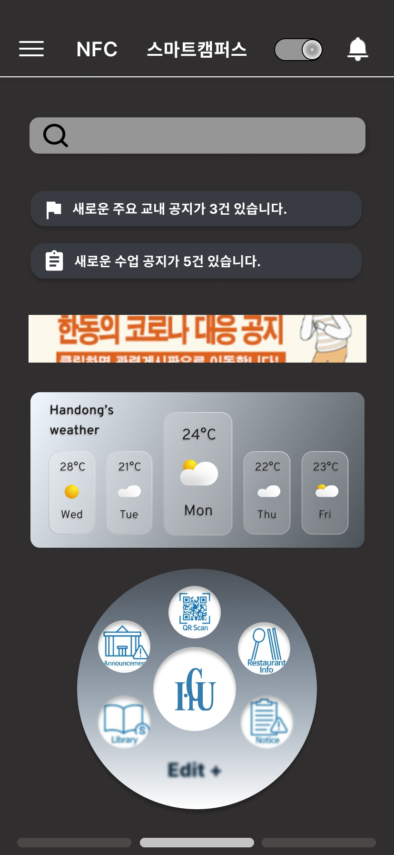
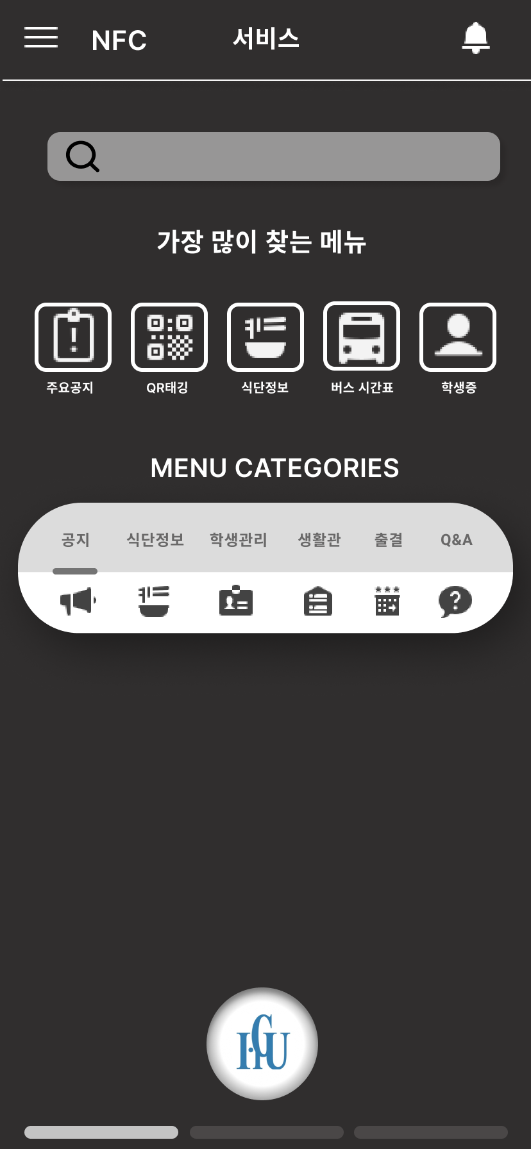
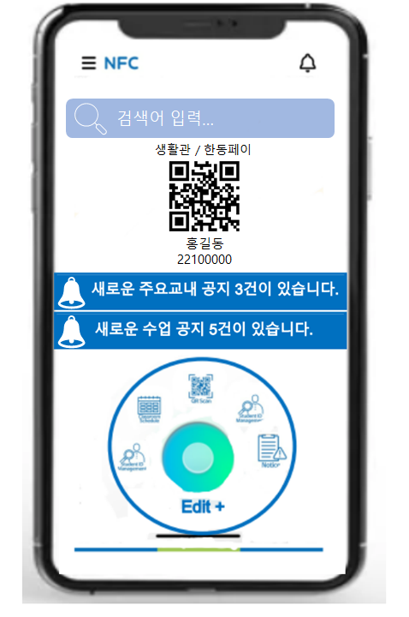
프로토 타입 변천사(정리 및 개선점 강조 필요)

Slide 7
Prototype user research
This is the result of conducting interviews with 18 people.
Improvements compared to the previous app
1. Intuitive reinforcement by changing UI design: Category classification, main screen information 2. Emotional Design: They liked the designally changed color and felt comfortable. 3. Add quick menu: Reduce time by organizing their own screen. 4. Physical consideration of users through dark mode: Reduce eye fatigue.

Slide 8
Prototype user research
Any inconvenience(improvement) in the current prototype
Removal: School Notice Banner, Weather Widget (Reasons for Functioning, Not Happy with Color), ID verification
Change: bell button and notice alarm button at the top right (there is no difference at present), quick menu, menu icon/font size (currently too small to recognize), dark mode button (currently difficult to intuitively recognize)
Add: Go to the Hiznet button, menus in the category

Slide 9
Plans for future development
1. Add alarm function: Time before class and attendance tagging alarm, alarm before closing assignment, alarm tailored to wake-up.
2. Add the HISNET Link and mobile version
3. Add a new menu: Classroom building information, facility reservation, bus location check, school department phone number through map.
4. Existing menu improvement: Handong Pay (Easy to use), food information (week/monthly), school notice (can be searched by number), ID verification (certification x)
5. Change the main screen: List the notice list, place it on the main screen of the most sought-after menu, remove the weather widget.
etc) Support for foreign languages, improve touch, and improve authentication errors.

Slide 10



Experiments
Purpose
To find a problem with an existing Smart Campus app and check whether the problem has been solved when Smart Campus is replaced with the new version
Supplies
Participants
Equipment
Methods
<Conditions>
Handong Students who use Smart Campus Application
Two students from each grace Freshman, Sophomore, and Junior and Senior
Compare the prototype to the existing smart campus
Get feedbacks from the users using an eye tracker.
Eye tracker
Cell phone
Camera
Survey Paper
Introduction of the experiment
Variables
Quantitative
How much you touched and how quickly you found it (count the second)
Qualitative
How convenient did user felt compare to the previous version (using eye tracker and interview)

Slide 11
Expected Outputs
Improve the Task
Performance
Improve the Physical
Discomfort
By categorizing the menus make it easy for users to find the information they want
By developing the dark mode provide comfort to users’ eyes
Improve the Satisfaction
By eliminating unused menus and identifying potential sources for supporting follow-up activities increase the users’ satisfaction.

